Slide 1
Time Series Analysis: U.S. Natural Gas Consumption
Peishan Liu, Juntao Zhang, Hongyue Zhu
May 2022

Slide 2
Outline
P A R T 0 0
Part 1 Get the Data & Prepare the Data
Part 2 Model Selection
Part 3 Predict & Forecast

Slide 3
Get the Data
&
Prepare the Data
P A R T 0 1

Slide 4
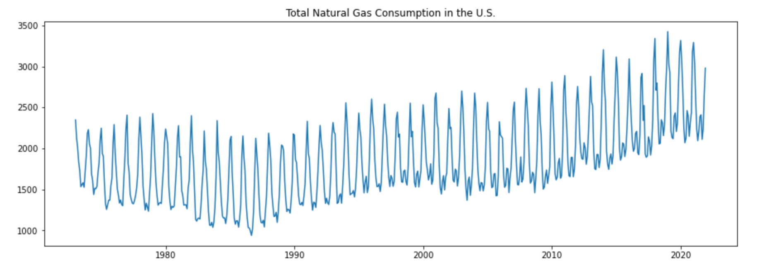
Get the Data
P A R T 0 1
Original Data: Monthly U.S. total natural gas consumption from 1973 January to 2021 December
Data Source: U.S. Energy Information Administration
https://www.eia.gov/totalenergy/data/monthly/

Slide 5
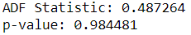
Check Stationarity of the Data
P A R T 0 1
Stationarity test on observed data: Apply augmented Dickey–Fuller test (ADF)
Null hypothesis: Series is non-stationary
Since p-value is larger than threshold 0.05:
Fail to reject the null hypothesis.
Time series is non-stationary.

Slide 6
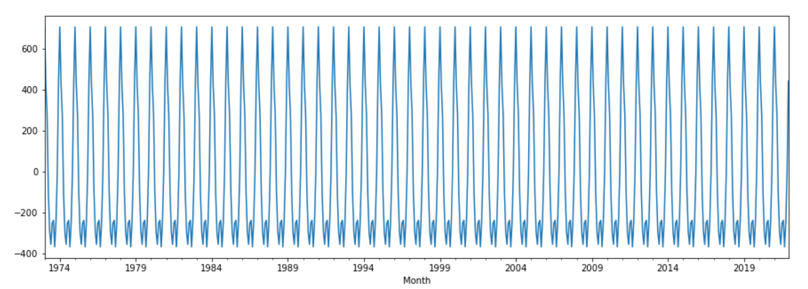
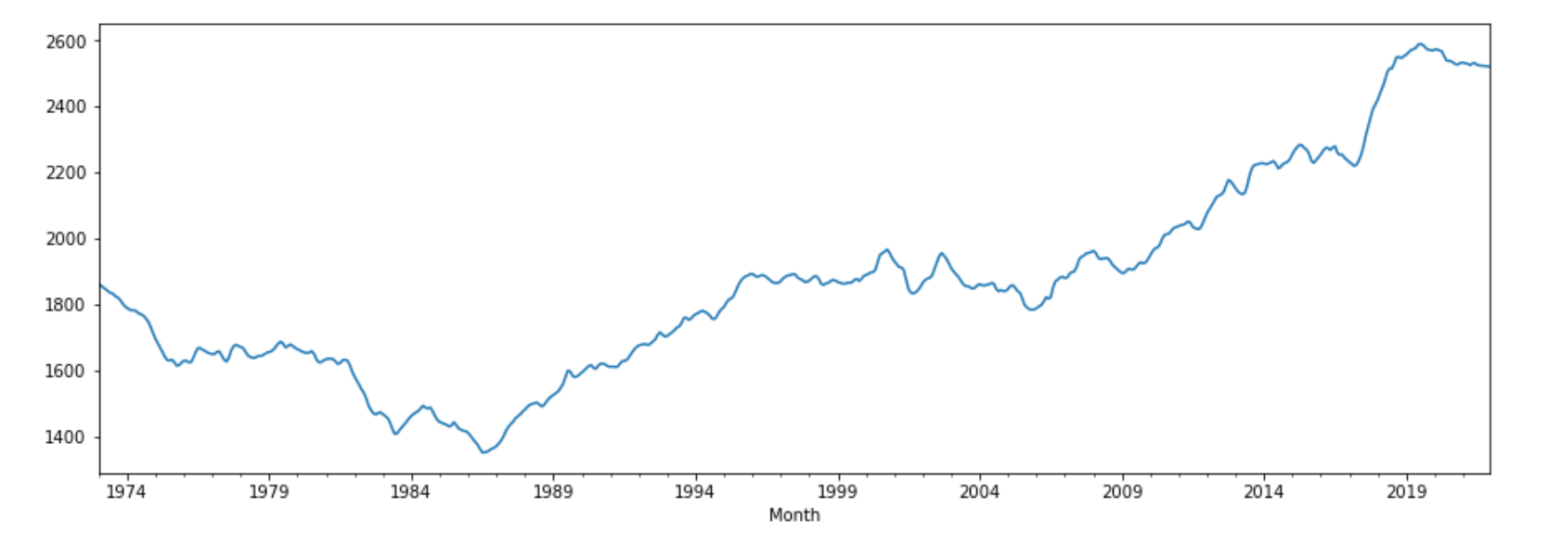
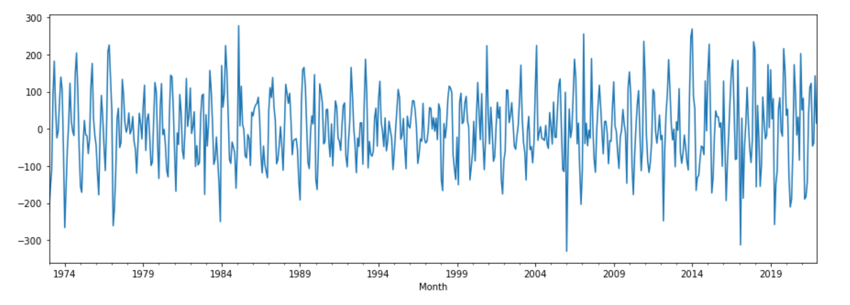
Decomposition
P A R T 0 1
Seasonal
Trend
Residual

Slide 7
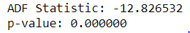
Check Stationarity of the Residuals
P A R T 0 1
Stationarity test on residuals: Apply augmented Dickey–Fuller test (ADF)
Since p-value is very small:
Reject the null hypothesis.
Data is stationary.

Slide 8
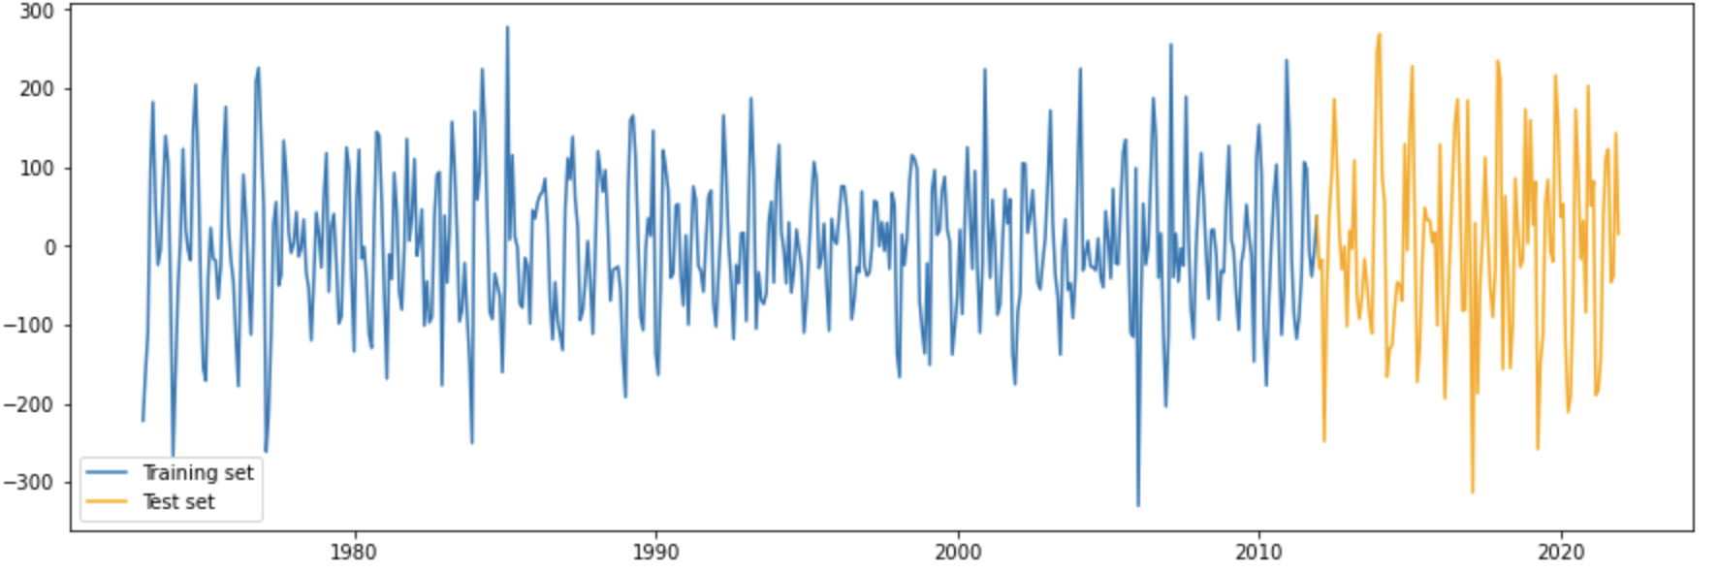
Train-Test Split
P A R T 0 1
Training: 01/01/1973 - 12/01/2011
Testing: 01/01/2012 - 12/01/2021

Slide 9
Model Selection
P A R T 02

Slide 10
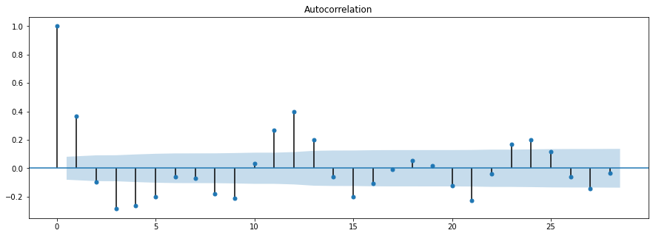
ACF Plot
P A R T 0 2
First, we want to take a look at the ACF and PACF plots.

Slide 11
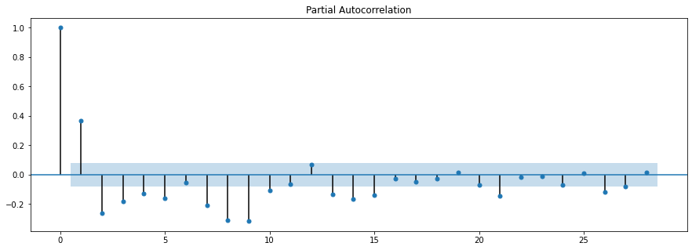
PACF Plot
P A R T 0 2

Slide 12
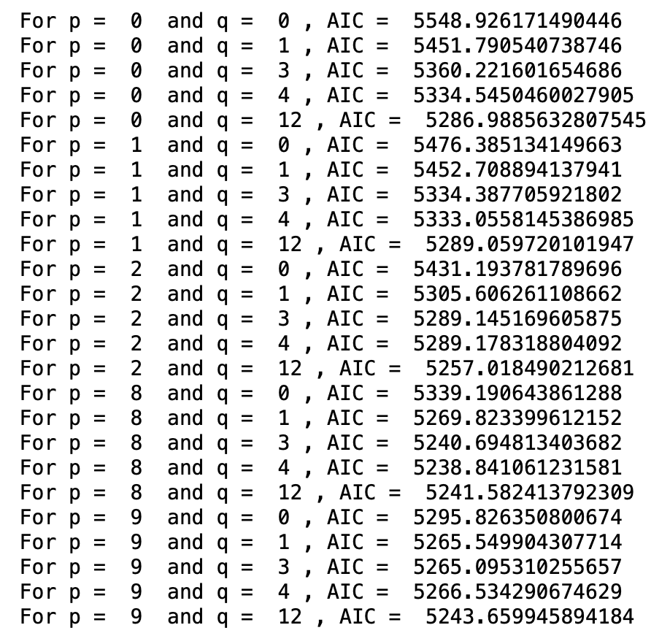
Build the Model
P A R T 0 2
Then, we want to try out different combinations of (p, q) on the training set.
The best model should minimize the AIC score.

Slide 13
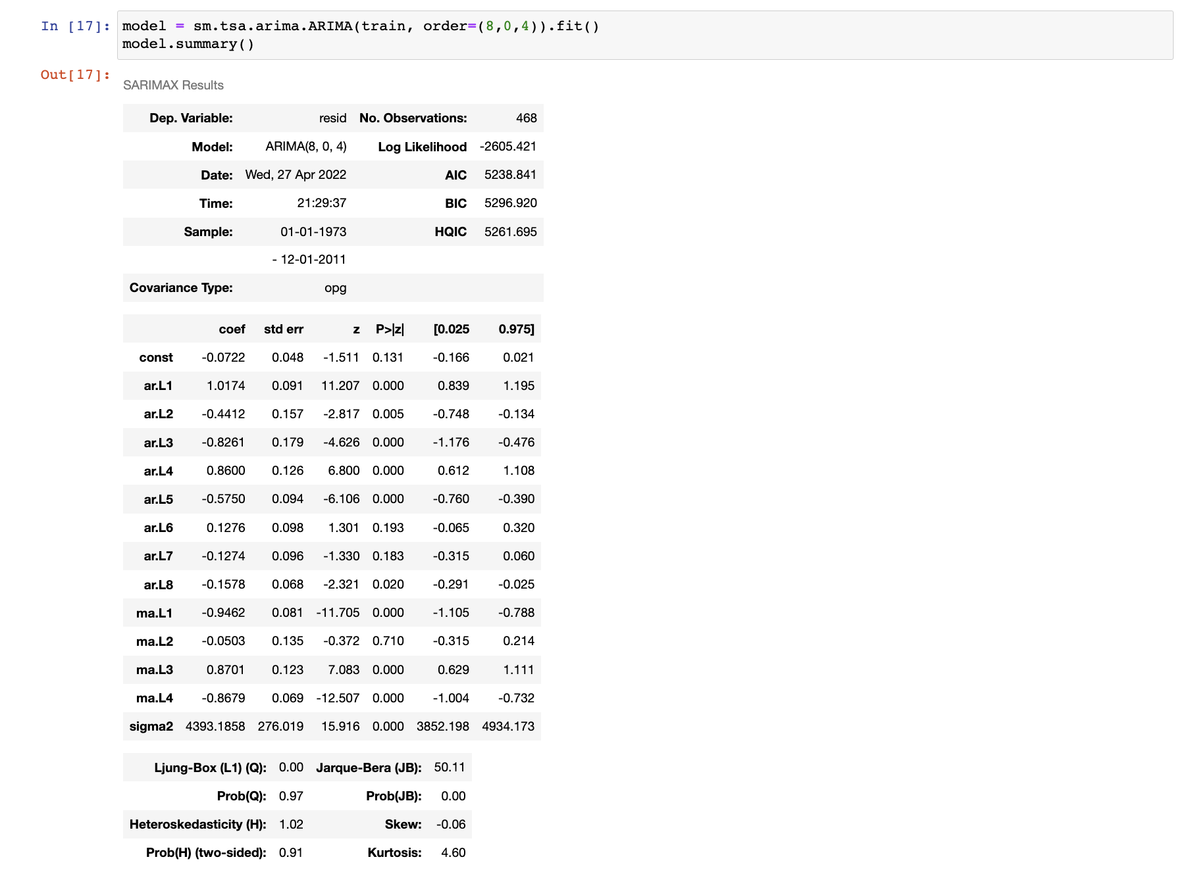
Model Selection
P A R T 0 2
Result indicates that (8,4) has the smallest AIC. Therefore, we will use ARMA(8,4) as our model.

Slide 14
Predict & Forecast
P A R T 03

Slide 15
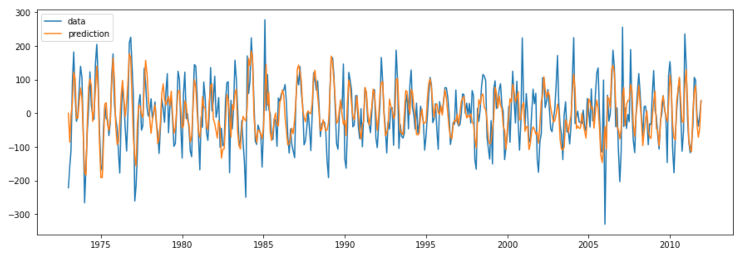
In-Sample Prediction on Residuals
P A R T 0 3
Predict on the training set.

Slide 16
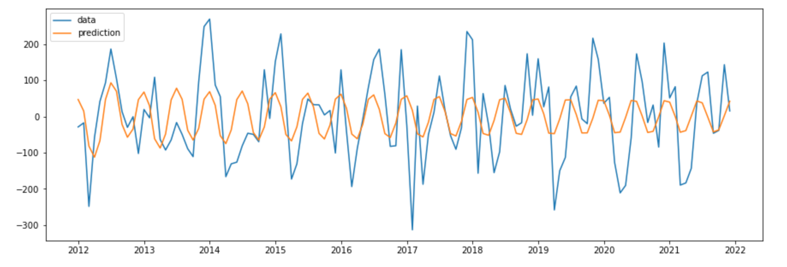
Out-of-Sample Prediction on Residuals
P A R T 0 3
Predict on the test set.

Slide 17
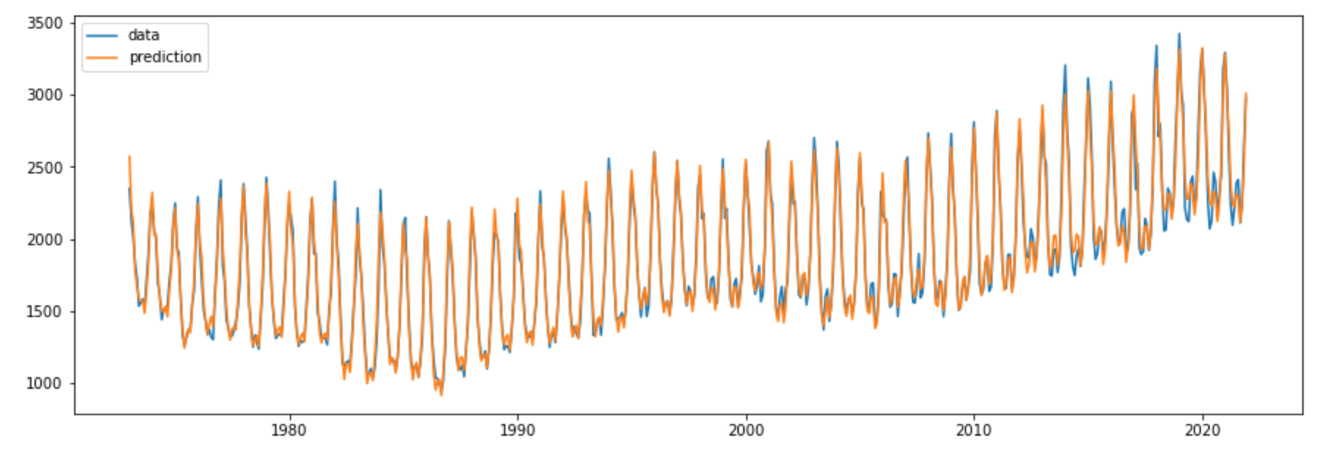
Overall Prediction
P A R T 0 3
We add back the trend and the seasonality and then make the overall prediction.

Slide 18
Observations
P A R T 0 3
The in-sample prediction is pretty good.
The out-of-sample prediction does capture the up and down oscillation pattern, but cannot reflect the true range of extreme values.
The overall prediction looks good, since the influence of trend and seasonality is much stronger than the influence of residuals.

Slide 19
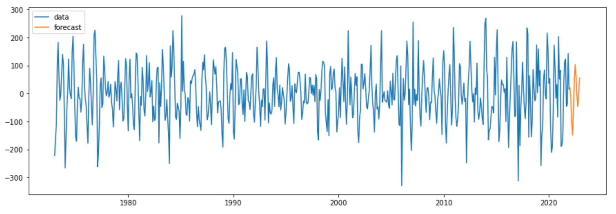
Next Year Forecast on Residuals
P A R T 0 3
We fit our model to the whole residuals data and forecast for the next year.

Slide 20
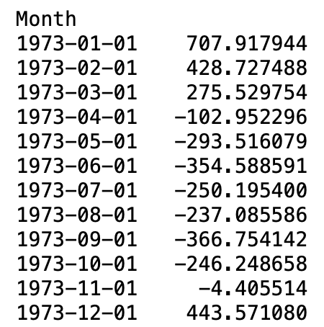
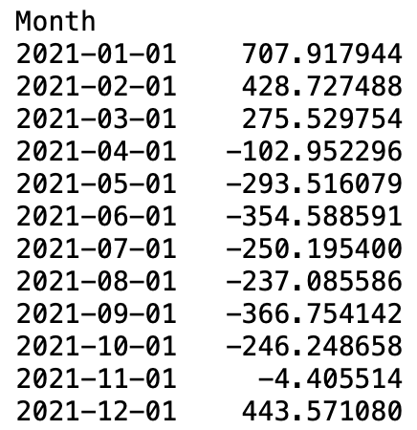
Next Year Forecast on Seasonality
P A R T 0 3
We first take a look at the seasonality data.

Slide 21
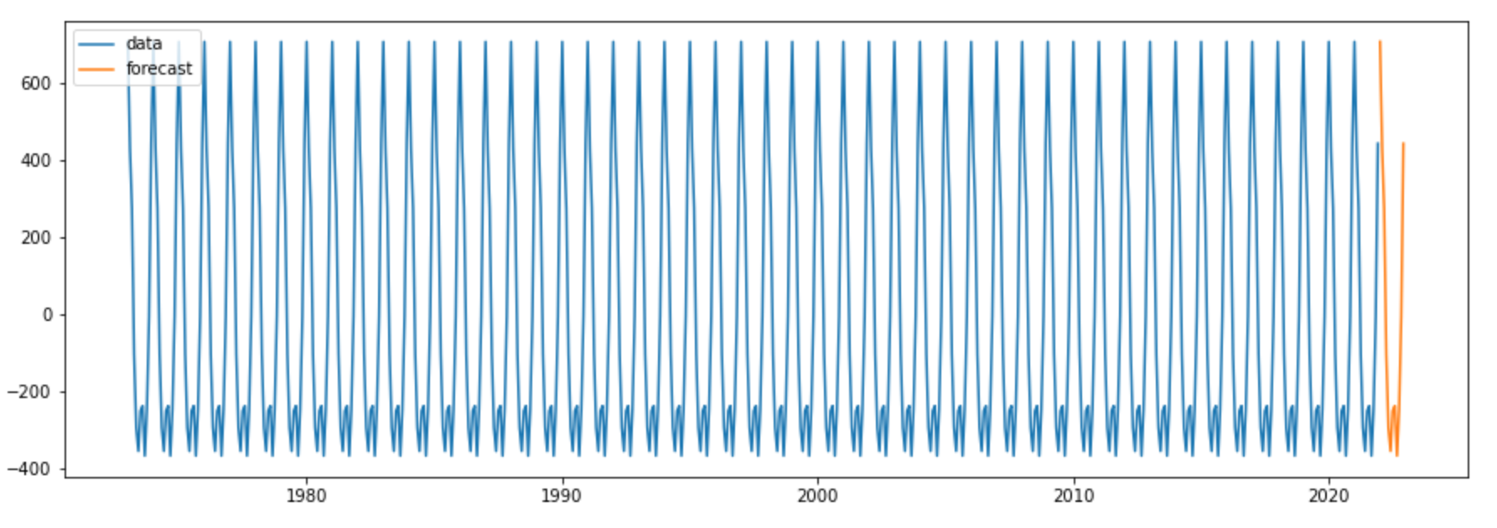
Next Year Forecast on Seasonality
P A R T 0 3
The forecast of seasonality is identical to the seasonality of previous years.

Slide 22
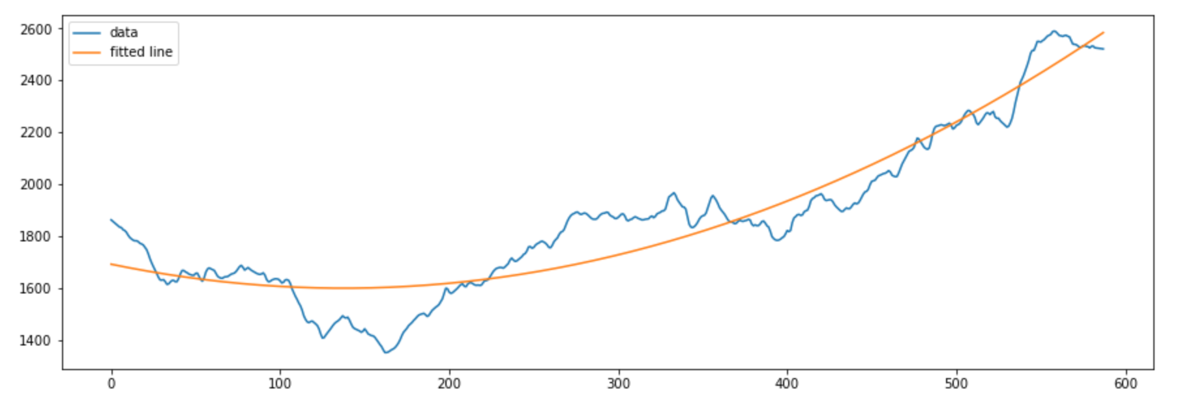
Next Year Forecast on Trend
P A R T 0 3
We’ve tried 1st, 2nd, 3rd, and 4th order polynomial regression.
The 2nd order polynomial regression fits the best.

Slide 23
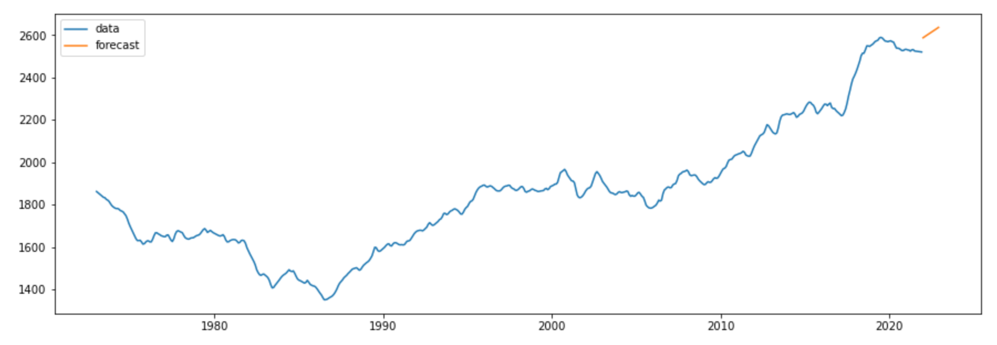
Next Year Forecast on Trend
P A R T 0 3
We make forecast of the trend based on the 2nd order polynomial regression.

Slide 24
The Jump in the Trend
Production of the natural gas in the U.S. spiked during 2016-2020. Production of gas reached a peak in Jan 2020, causing decrease in natural gas price and high demands over the past few years. The jump of the natural gas consumption in the trend between 2019 and 2020 is caused by the price drop.
After 2020, the production of the natural gas dropped due to COVID pandemic and, as a result, leading to higher prices and lower demands. We observe from the graph that consumption of natural gas has slumped after 2020.
If, in a hypothetical world, there is no pandemic, then given the analysis above, we might expect the natural gas consumption to continuously grow.

Slide 25
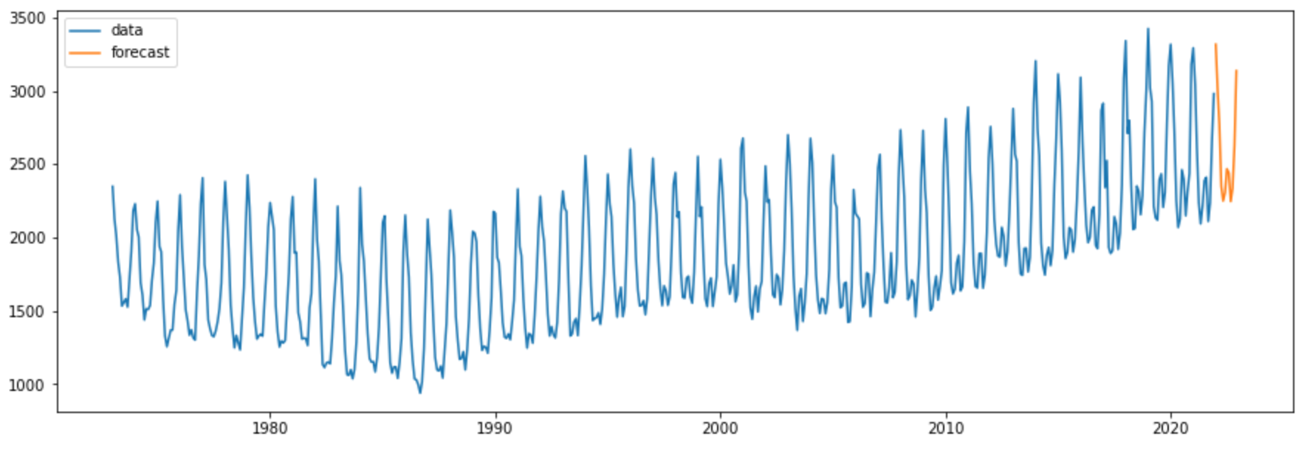
Overall Forecast
P A R T 0 3
We add the forecast of residuals, seasonality, and trend all together.

Slide 26
Final Thoughts
The U.S. total natural gas consumption has clear trend and seasonality.
We used ADF test to evaluate the stationarity of raw data, and we found that the raw data is not stationary.
We used the seasonal decomposition to address the problem of non-stationary.
The decomposition results show a clear seasonal component with a cycle of 12 months.
ARMA(8,4) model gives us the best out-of-sample performance.
The jump in the trend between 2019 and 2020 may cause the forecast in trend is higher than the future actual value.

